Slide 1


NAU CAPSTONE
PCI BIG BEAM TEAM
CENE 486C | April 16, 2021
Natalie Noroian, Nicole Neilson, Jackie Crowley, and Elena Reyes

Slide 2



PROJECT INTRODUCTION
Each beam will be judged on the following criteria:
    Design Accuracy
    Cost
    Weight
    Deflection
    Accurate Predictions
    Report Quality
    Practicality, Innovation, & Conformance with Code
Figure 1: Image in PCI Big Beam Competition Rules [1]
Precast/Prestressed Concrete Institute (PCI) Big Beam Competition
Students will design a precast/prestressed concrete beam
Client: PCI Competition Judges and PCI Producing Member (Tpac)
Technical Advisor: Dr. Robin Tuchscherer
Figure 2 and 3: PCI and Tpac Company Logos

Slide 3
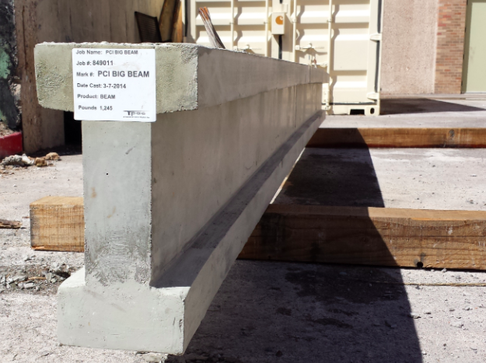
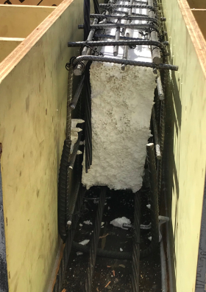
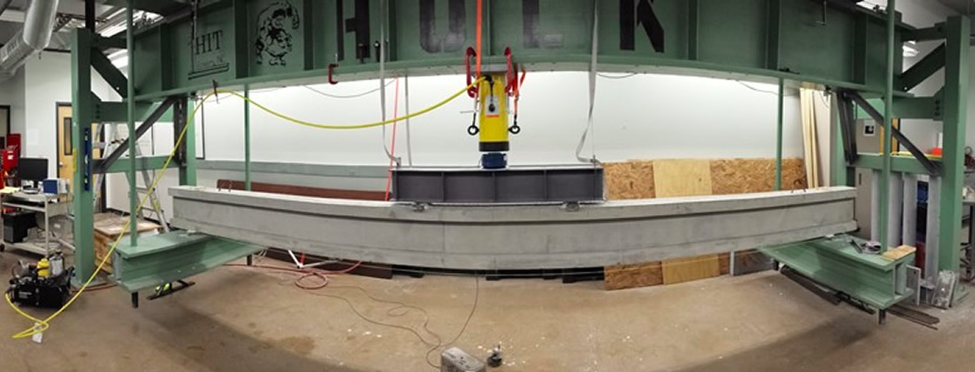
PROJECT INTRODUCTION
Competition History:
NAU Capstone teams have competed since 2013
NAU’s Capstone team won 2018 Best Report
NAU’s Capstone team placed 3rd for Zone 1 in 2013 & 2014
Figure 5: NAU’s Capstone Team 2013-2014 I-beam [2]
Figure 6: NAU’s Capstone Team 2017-2018 beam [3]
Figure 4: NAU’s Capstone Team 2013-2014 beam before testing [2]

Slide 4
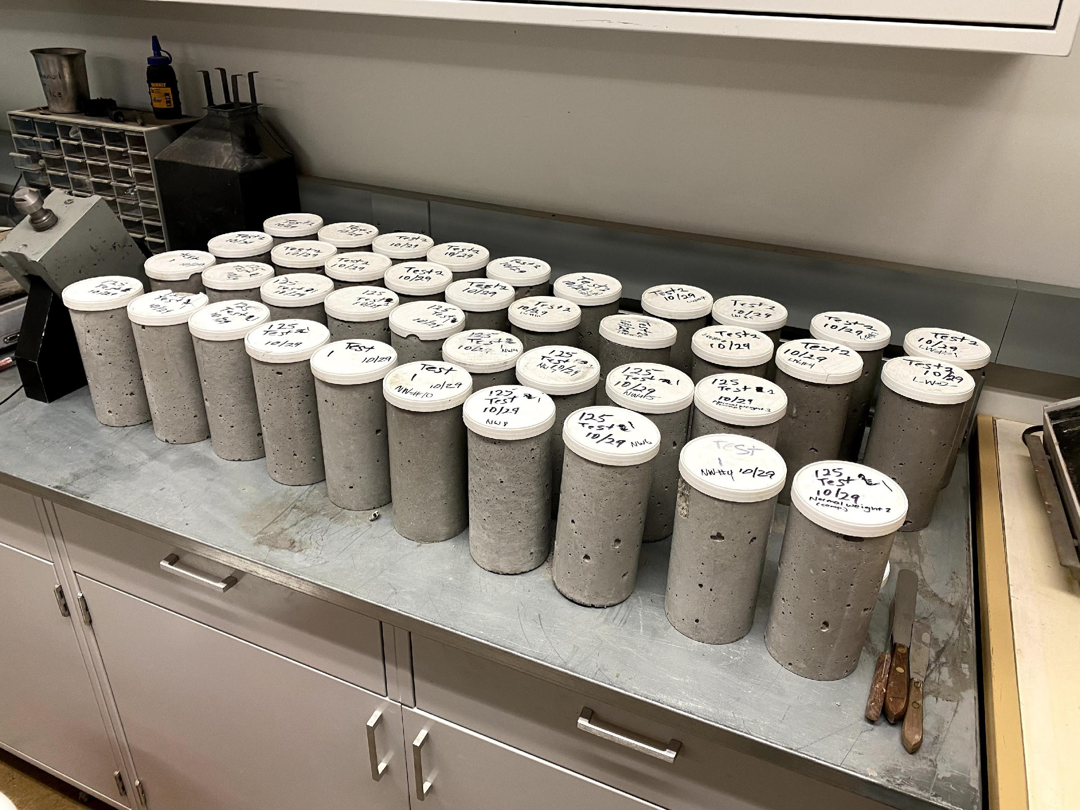
CONCRETE MIX SELECTION
Tpac’s mix historically outperforms other mixes
Light-weight vs. Normal-weight
Focus on developing statistically significant data
(40) 4x8 Concrete Cylinders | (20) Light-weight | (10) Tension Test
 |  | (10) Modulus of Elasticity Test and Compression Test
 | (20) Normal-weight | (10) Tension Test
 |  | (10) Modulus of Elasticity Test and Compression Test
Figure 7: Forty Cylinders Received from Tpac
‹#›

Slide 5
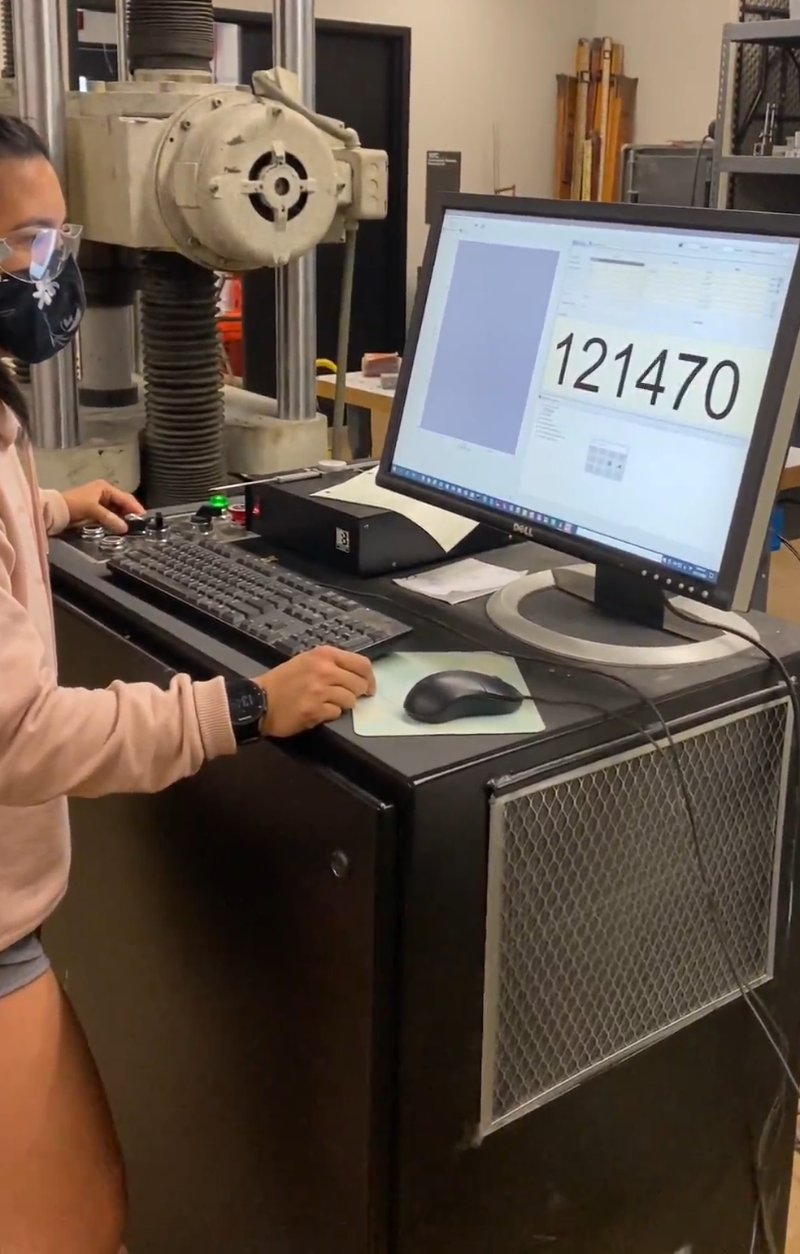
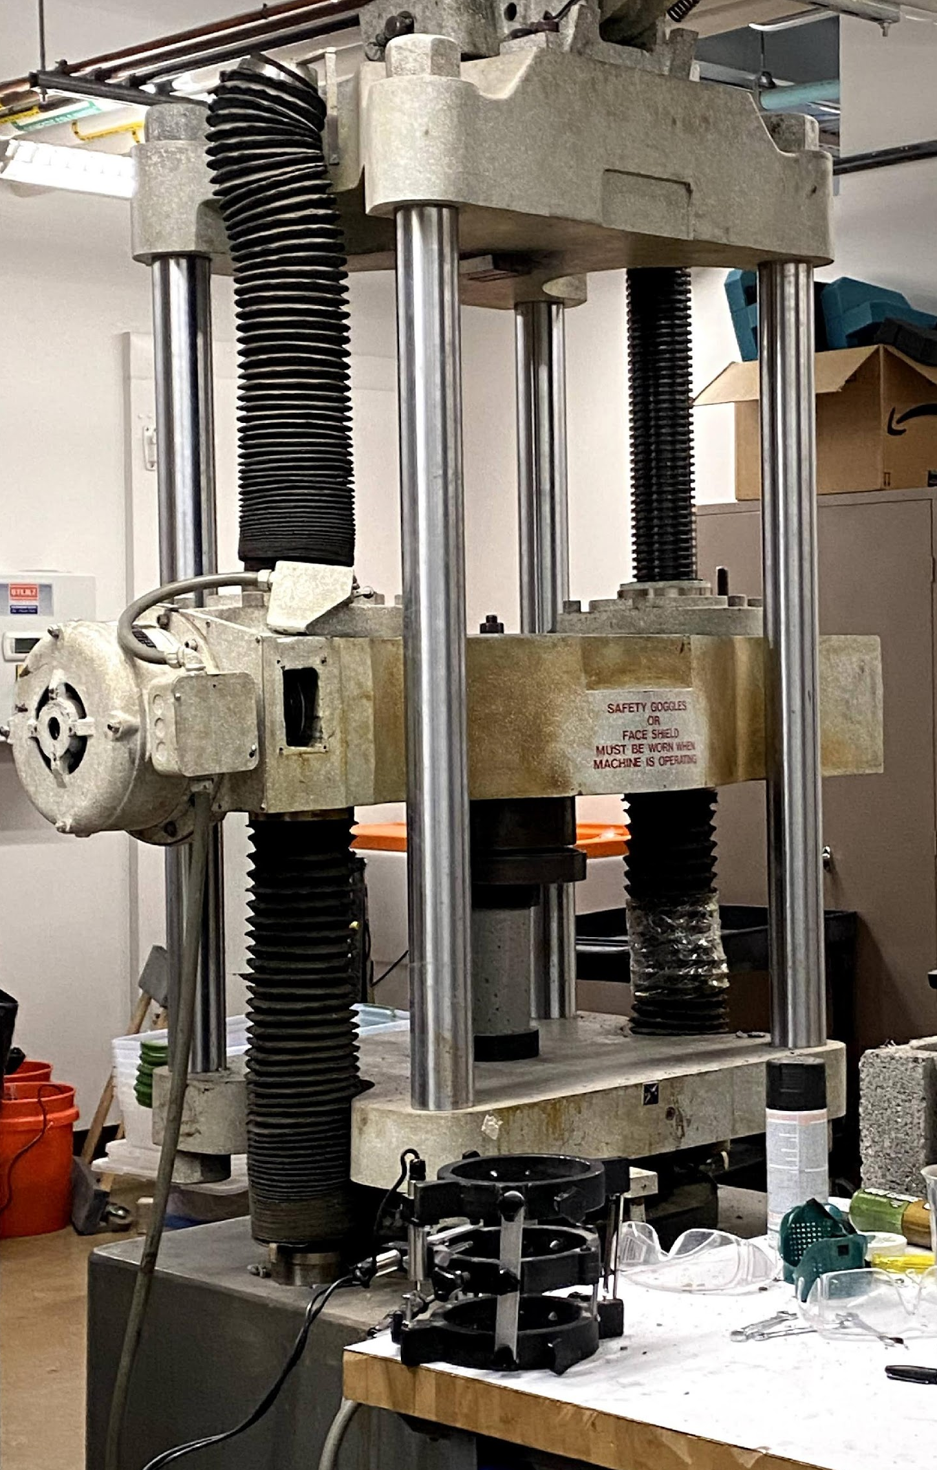
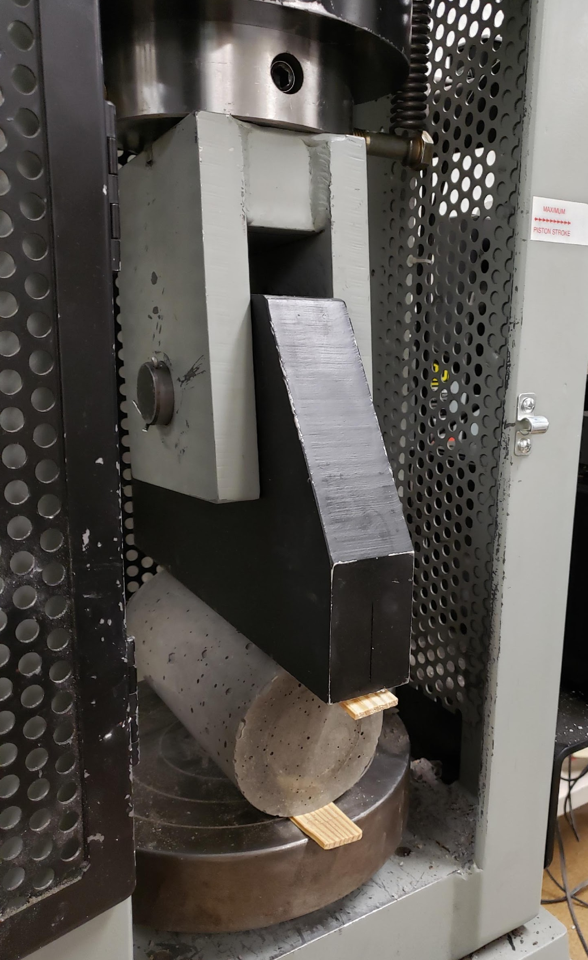
MODULUS OF ELASTICITY TEST
TENSION TEST
COMPRESSION TEST
Notes:
Discuss overview of testing and the purpose of each test in relation to beam design.

Slide 6
NORMAL-WEIGHT MODULUS OF ELASTICITY (MOE) RESULTS
Normal-weight MOE: 4.53 x (10^6) psf
‹#›

Slide 7
LIGHT-WEIGHT MODULUS OF ELASTICITY (MOE) RESULTS
Light-weight MOE: 3.39 x (10^6) psf
‹#›

Slide 8
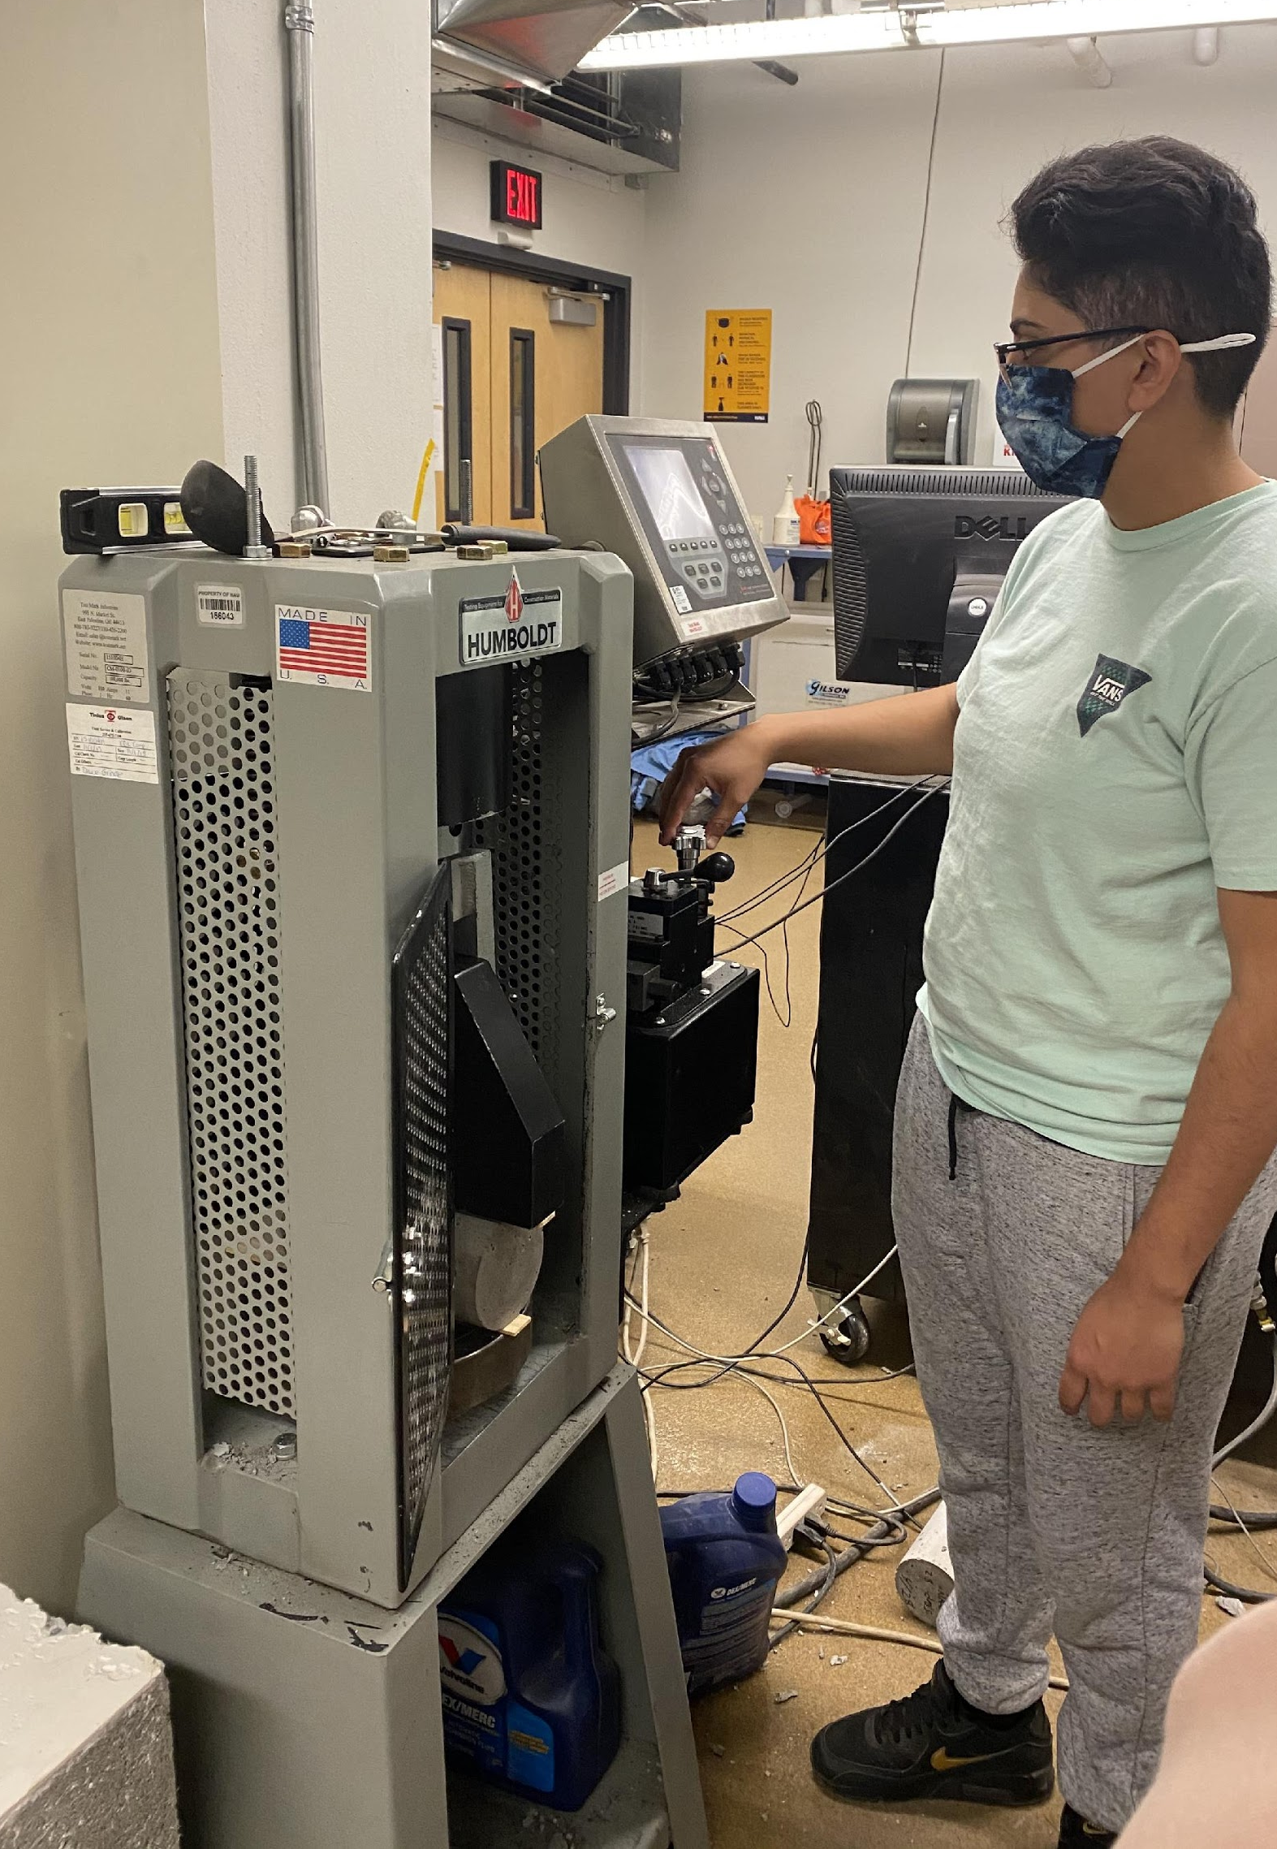
SUMMARY OF TEST RESULTS
Table 1: Complete Test Results for Light-weight and Normal-weight Concrete
 | Light-weight Concrete | Normal-weight Concrete
Average Compressive Stress | 9.61 ksi | 9.54 ksi
Average Tensile Stress | 2.65 ksi | 2.49 ksi
Average Modulus of Elasticity | 23.53 ksi | 31.47 ksi
Light-weight Concrete Mix Unit Weight = 124 pcf
Normal-weight Concrete Mix Unit Weight = 145 pcf
Figure 8: Conducting Tension Test

Slide 9
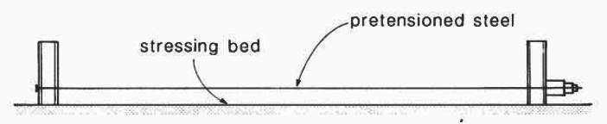
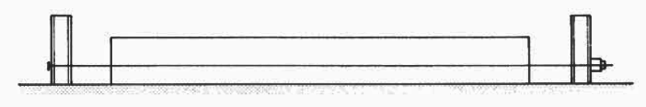
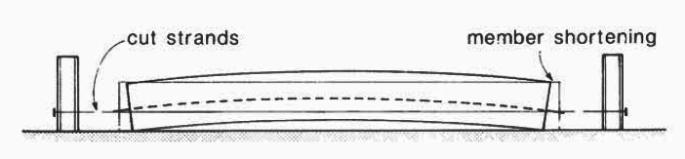
PRECAST/PRESTRESSED BEAM DESIGN
Design Goals for Competition:
    Low Weight
    High Deflection
    Applied cracking load > 20 kips
    32 kips < Ultimate applied load < 40 kips
Figure 9: Prestressing Concrete Through Pretensioning Technique [4]
Notes:
Precast/Prestressed design:
Tensioning or pulling of prestressing steel by pulling at a jacking force of 31 kips in the bed before casting the concrete
Cast concrete around the tensioned steel
Release the strands from the bed once the desired strength has been reached (causes a beam cambering effect which is the bending of the beam)
Goals of Prestressing Design:
minimize or eliminate cracking of the beam at service loads
control deflections
allows for more slender structures

Slide 10

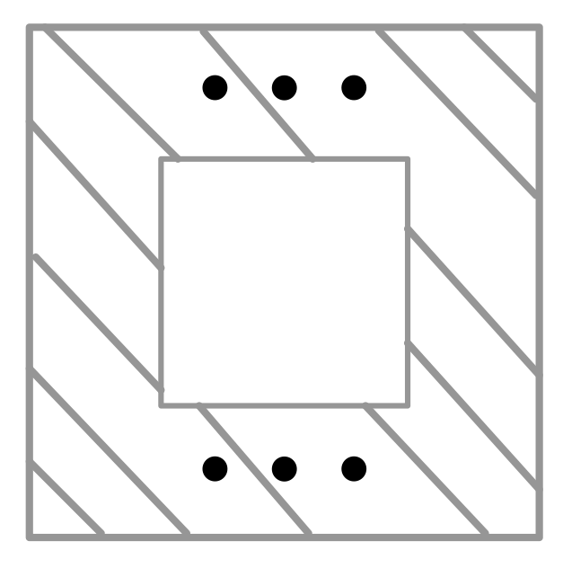
PRECAST/PRESTRESSED BEAM DESIGN
CROSS SECTIONS CONSIDERED
    FLANGE
    REBAR
    REBAR
    WEB
    FLANGE
    STRANDS
    STRANDS
I-BEAM
BOX BEAM
Notes:
To begin the beam design process:
Considered PCI Competition rules for constraints
Considered 2 different beam cross sections and 10 different beam designs
In order to evaluate different designs an excel spreadsheet solver was created
This spreadsheet would allow the team to isolate each variable in a cross section to see how it affected the beam's strength and the deflection it would experience
allowed manipulation to dimensions of flange and web
manipulation to the area of compression rebar in the top flange
Manipulation to the area of prestressing strands in the bottom flange

Slide 11
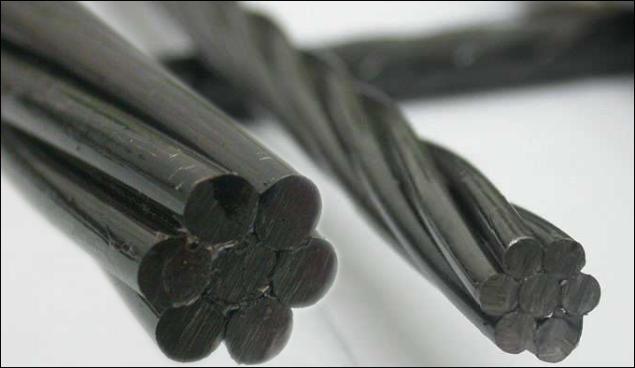
STRUCTURAL DESIGN
Tpac Design Parameters:
½” diameter low relax strands for prestressing steel
Compressive strength of concrete at 3 days: 5,000 psi
  Prestressing strands are released
Compressive strength of concrete at 28 days: 8,000 psi
  Beam is at testing strength
Figure 10: Prestressing Strand
Notes:
Figure 10 shows a prestressing strand which has steel intertwined to allow for more strength
Compressive strength at 3 days used for calculating release stress
Compressive strength at 28 days used for calculating cracking strength of the beam

Slide 12
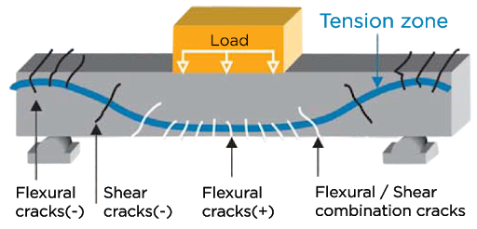
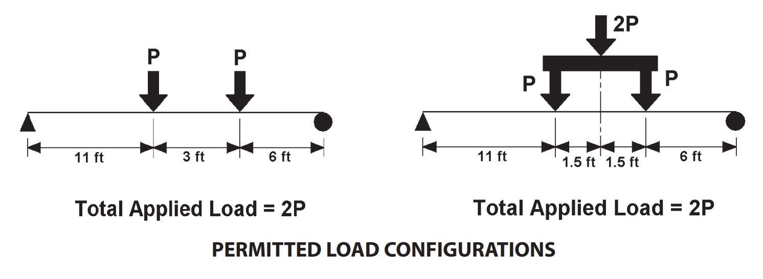
STRUCTURAL DESIGN
The PCI Competition loading configuration:
Used to calculate the moments due to loading
Determine the load that would cause cracking
Figure 11: Types of Beam Cracks [5]
Figure 12: Loading configuration for beam test [1]
Notes:
-Figure 12 shows the loading configuration with 2 point loads on our 20 foot beam span.
-1 point load located at 11 feet from the left and 1 point load located at 14 feet from the left
- configuration was useful in determining our moment within the beam which then allowed us to calculate the load at which the beam would begin cracking
-FIgure 11 shows visual representation of types of beam cracks that occur from applied loading

Slide 13
STRUCTURAL ANALYSIS
WIDTH OF BOTTOM FLANGE
CRACKING LOAD
ULTIMATE STRENGTH
COMPRESSION REBAR
DUCTILITY
DEFLECTION
CRACKING LOAD
NUMBER OF STRANDS
ULTIMATE STRENGTH
AREA OF CONCRETE
DEFLECTION
Notes:
-findings
-With findings we were able to create a beam design with all of the desired criteria for the PCI big beam competition

Slide 14
DESIGN SELECTION
Table 1: Decision Matrix for Final Design
Criterion: | Cost |  | Weight |  | Deflection
Weight: | 0.20 |  | 0.30 |  | 0.50
Cross Section | Score | Weighted Score | Score | Weighted Score | Score | Weighted Score | Total Score
1 (I-Beam) | 0.64 | 0.13 | 0.73 | 0.22 | 0.40 | 0.20 | 0.55
2 (Box Beam) | 0.79 | 0.16 | 0.86 | 0.26 | 0.20 | 0.10 | 0.52
3 (I-Beam) | 1.00 | 0.20 | 0.83 | 0.25 | 0.20 | 0.10 | 0.55
4 (I-Beam) | 0.63 | 0.13 | 0.77 | 0.23 | 0.40 | 0.20 | 0.56
5 (I-Beam) | 0.65 | 0.13 | 0.84 | 0.25 | 0.40 | 0.20 | 0.58
6 (I-Beam) | 0.58 | 0.12 | 0.95 | 0.29 | 0.40 | 0.20 | 0.60
7 (I-Beam) | 0.74 | 0.15 | 0.72 | 0.22 | 0.40 | 0.20 | 0.56
8 (I-Beam) | 0.49 | 0.10 | 1.00 | 0.30 | 0.60 | 0.30 | 0.70
9 (I-Beam) | 0.39 | 0.08 | 0.51 | 0.15 | 0.80 | 0.40 | 0.63
10 (I-Beam) | 0.23 | 0.05 | 0.77 | 0.23 | 1.00 | 0.50 | 0.78
Notes:
-Through our structural analysis, we were able to determine a decision matrix process where cost, weight, and deflection were used to score each beam design
-Beam Design 10 scored the highest which had a cracking capacity of ___, and ultimate capacity of ____, the largest deflection, low cost and low weight

Slide 15
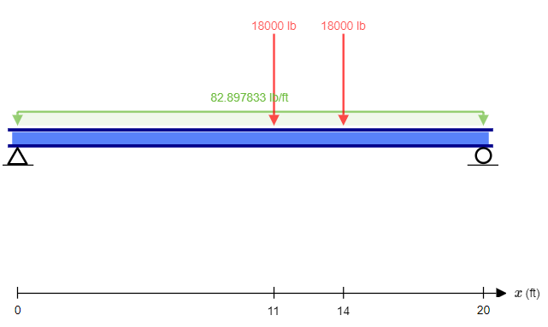
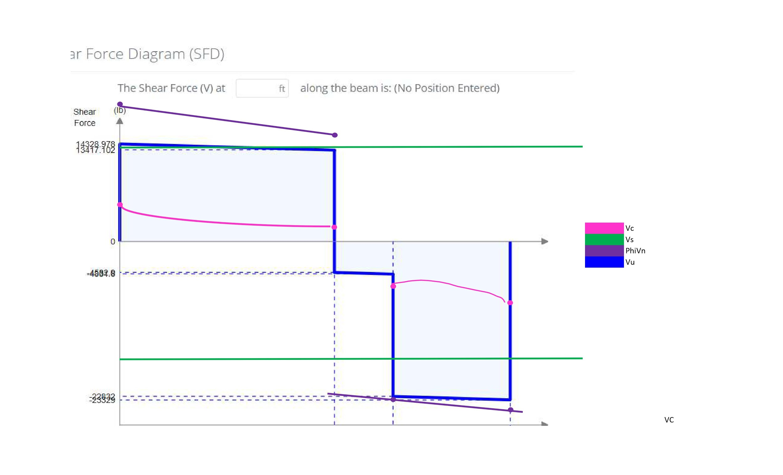

SHEAR DESIGN
Figure 13: Loading Diagram
Shear Force (lb)
Shear capacity design follows American Concrete Institute (ACI) Code 318-19 Provision 22.5- One Way Shear Strength
Vn > Vu to avoid shear failure
No. 4 Alternating Stirrups at 6” O.C.
14328.978
13417.102
Length (ft)
-4532.8
-4534.6
Vc (Shear Strength of Concrete)
Vs (Shear Strength of Stirrups)
PhiVn (Design Shear)
Vu (Ultimate Shear)
-22832
-23329
Figure 14: Shear Force Diagram

Slide 16
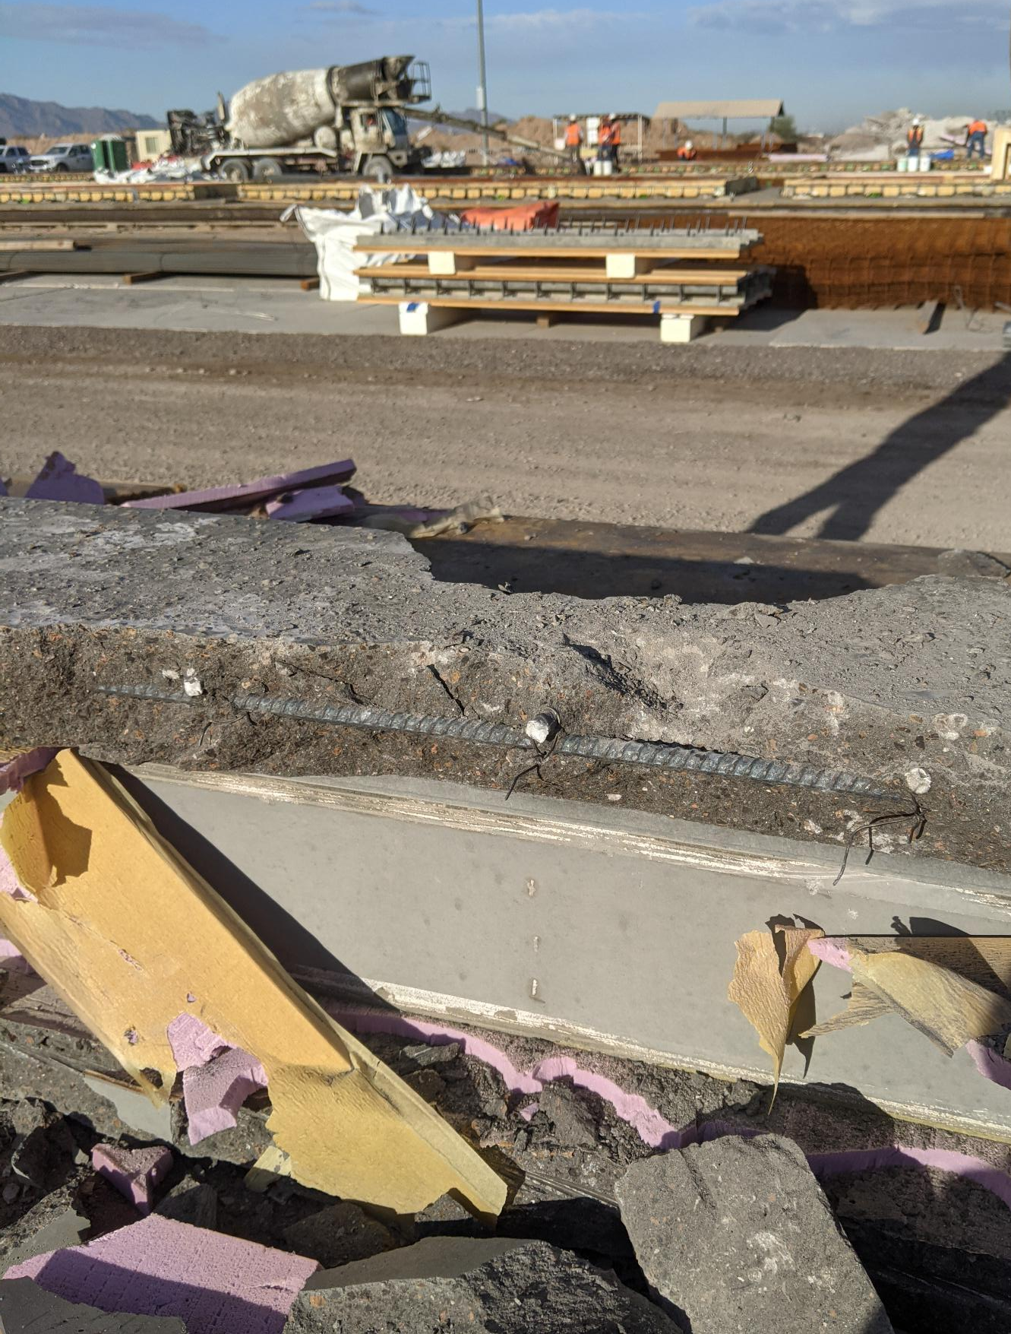
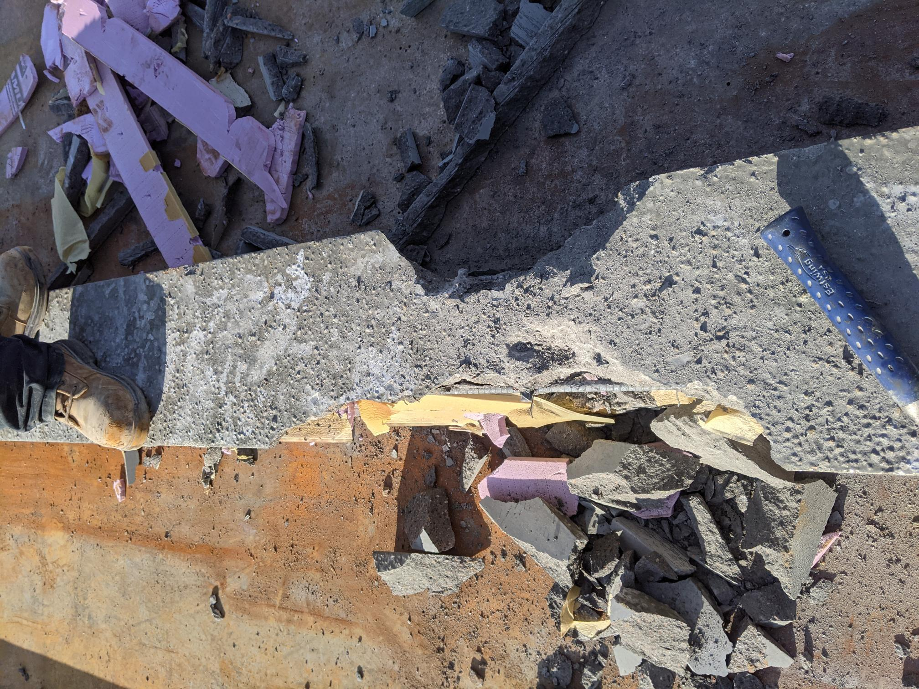
BEAM FAILURE
CONCRETE BLOWOUT
UNCONFINED STRANDS
Figure 17: Force Transfer Trough Beam
Figure 15 and 16: Failure of Beam at Release of Strands

Slide 17
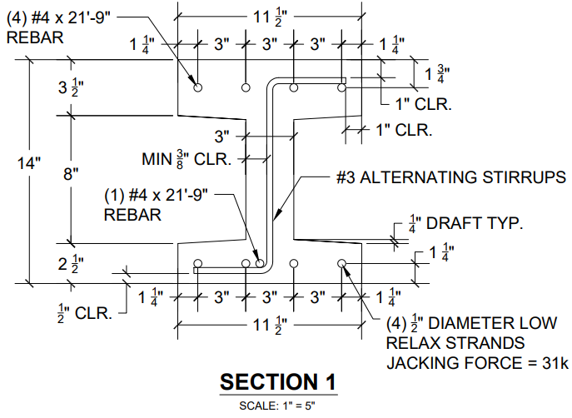
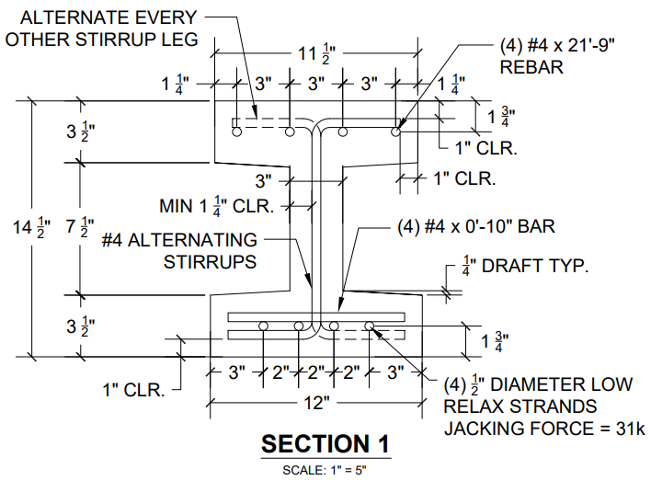
DESIGN REVISIONS
ORIGINAL DESIGN
REVISED DESIGN

Slide 18
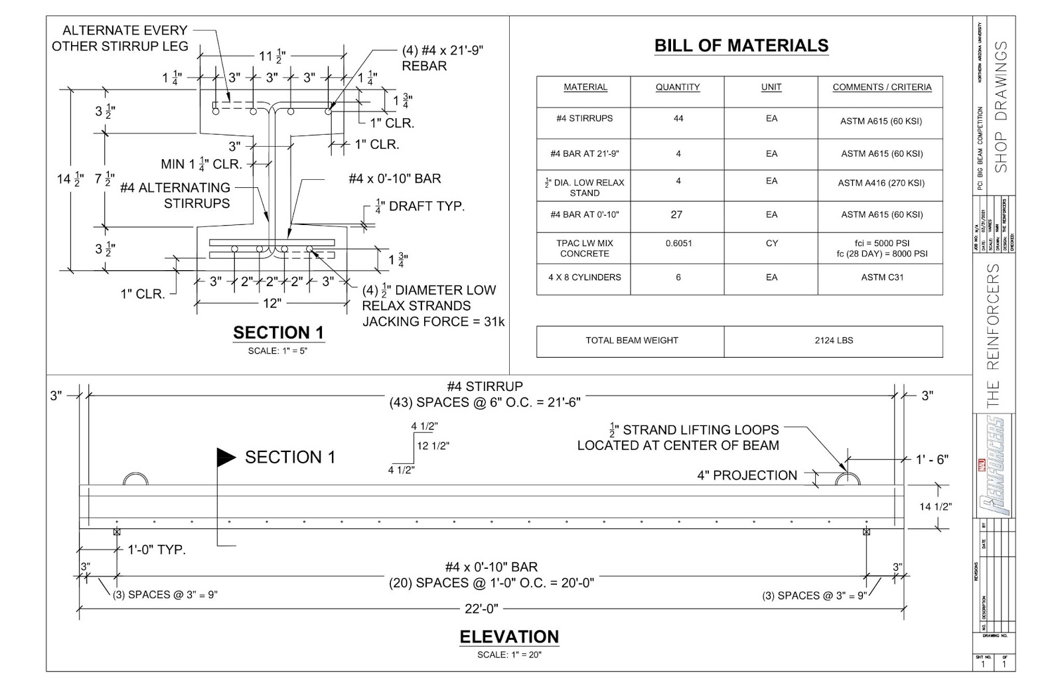
FINAL SHOP DRAWINGS
Figure 18: Final Revised Shop Drawings Sent to Tpac

Slide 19
IMPACTS
Competition/Project Specific
Precast/Prestressed Concrete Construction
SOCIAL
  Attract students to NAU’s Engineering programs
  Injury in testing
  Short construction delays for community
  Public health concerns, land necessary for waste
ECONOMIC
  Work for employees at Tpac
  Tpac sponsored the team without direct compensation
  Less material to get same deflection as non-prestressed
  Extra cost for delivery of materials, extra delay and coordination, errors in construction
ENVIRONMENTAL
  Used available materials at Tpac
  Disposal of broken beam, vehicle emissions in delivery
  Rebar and concrete can be recycled
  Portland cement produces carbon dioxide

Slide 20
REFERENCES
[1] PCI Big Beam Competition Rules, PCI, 2021.
[2] NAU Capstone Team 2013-2014 Website. https://ceias.nau.edu/capstone/projects/CENE/2014/PCI/The%20Beam.html
[3] NAU Capstone Team 2017-2018 Website. https://ceias.nau.edu/capstone/projects/CENE/2018/PCIBigBeam/index.html
[4] Prestressed Basics Document.
[5] Smart Fiber, Structural Behavior. 2019. http://smartfiber.co.in/structural-behaviour/
QUESTIONS?

